Slide 1
Math Game
Week 7 and 8 Progress
By: Gavin Davy, Michael Erickson, and Rena Sakai

Slide 2
SE 2200
Status Report #: | 2 | Date From: | 10/05/20 | Date To: | 10/18/20
Project Title: | Math Game

Slide 3
Team Members:
Team Members
Gavin Davy
Michael Erickson
Rena Sakai

Slide 4
Meeting Minutes Week 7
Date: | 10/07/20 | Time: | 2PM - 3PM
Who Attended? | What was discussed?
Gavin | This week’s action items
Michael
Rena

Slide 5
Meeting Minutes Week 7
Date: | 10/08/20 | Time: | 9AM-10AM
Who Attended? | What was discussed?
Gavin | Groups progress on this week’s action items
Michael | Finishing User Screens
Rena | Further discussed this week plan

Slide 6
Meeting Minutes Week 8
Date: | 10/12/20 | Time: | 2PM - 3PM
Who Attended? | What was discussed?
Gavin | Difficulties linking user screens and resources to overcome those difficulties
Michael | Linking xml and java
Rena

Slide 7
Meeting Minutes Week 8
Date: | 10/14/20 | Time: | 2PM - 3PM
Who Attended? | What was discussed?
Gavin | Checking each person’s work
Michael
Rena

Slide 8
Meeting Minutes Week 8
Date: | 10/18/20 | Time: | 6PM - 7PM
Who Attended? | What was discussed?
Gavin | Checking each person’s work
Michael | Final updates to progress report
Rena | Updating/uploading files to GitHub

Slide 9
Action Items Week 7 and Week 8
Action Items | Summary of Progress
Finish High Score screen | In progress. Need to finish layout.
Begin Java coding to connect screens | In progress. Have found useful resources and successfully linked titleScreen and levelSelect.
Update credit and individual level screens | Completed. Need to create links between screens.

Slide 10
This Weeks Accomplishments
Team Member | Description of task | Hours Spent | Problems Encountered & Solutions
Gavin | Create High Score screen
Michael | Linked screens | 3 hrs | Finding useful examples. Found https://www.youtube.com/watch?v=bgIUdb-7Rqo
Rena | Added buttons | 1hr 30min
Michael | Resolved issues with ConstraintLayout on levelSelect screen | 2 hrs | Found the following article: https://developer.android.com/reference/androidx/constraintlayout/widget/ConstraintLayout
 | Update Progress Report | 1 hr

Slide 11
This Weeks Accomplishments Continued
Team Member | Description of task | Hours Spent | Problems Encountered & Solutions
Rena | Updated a credit screen | 1hr 30min

Slide 12
Project Submissions
Individual Group Work

Slide 13
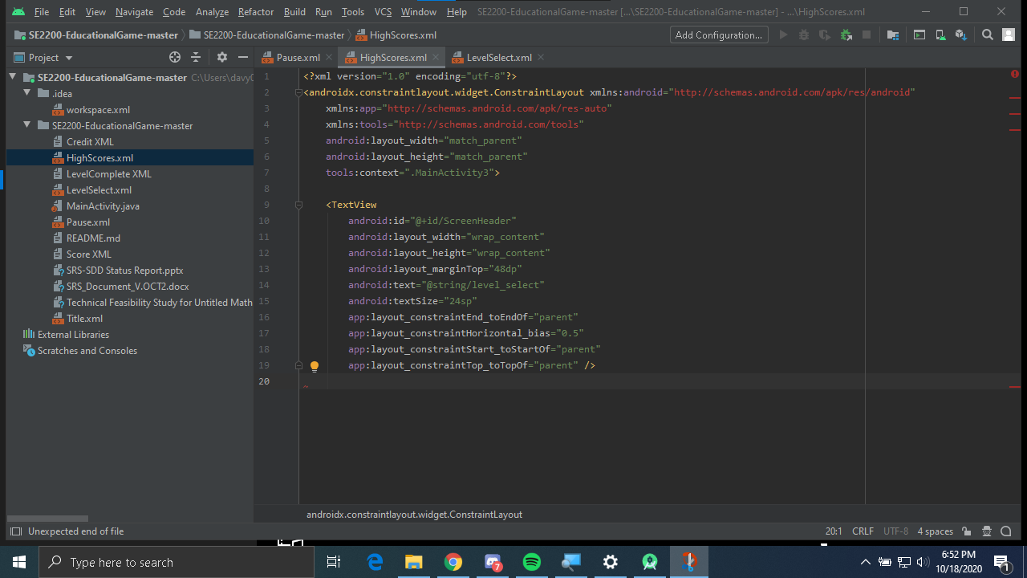
Contributions from Gavin
In progress- High Score Screen formatting to be inline

Slide 14
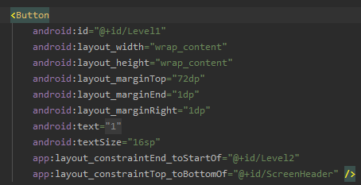
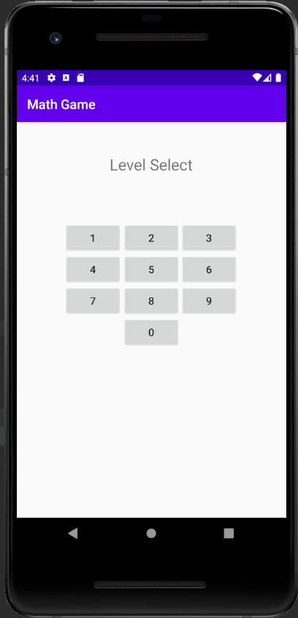
Contributions from Michael
Updated levelSelect.xml, so that buttons display properly on phone display. Required adding additional constraints to the each of the buttons.

Slide 15
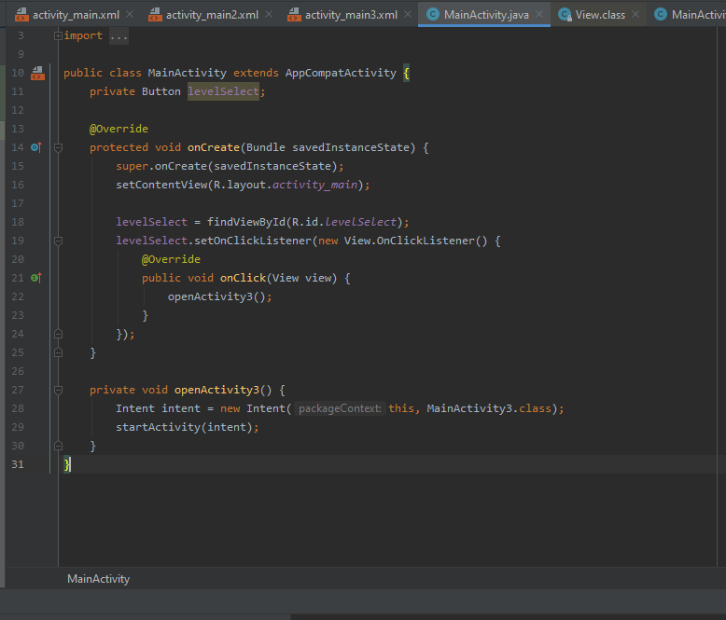
Contributions from Michael
Updated the MainActivity.java file to create link between the title screen and the level select screen.
Will look to create similar links between other screens in following weeks.

Slide 16
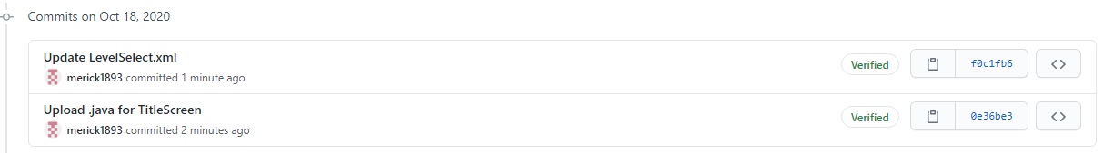
Contributions from Michael
Updates pushed to GitHub.

Slide 17
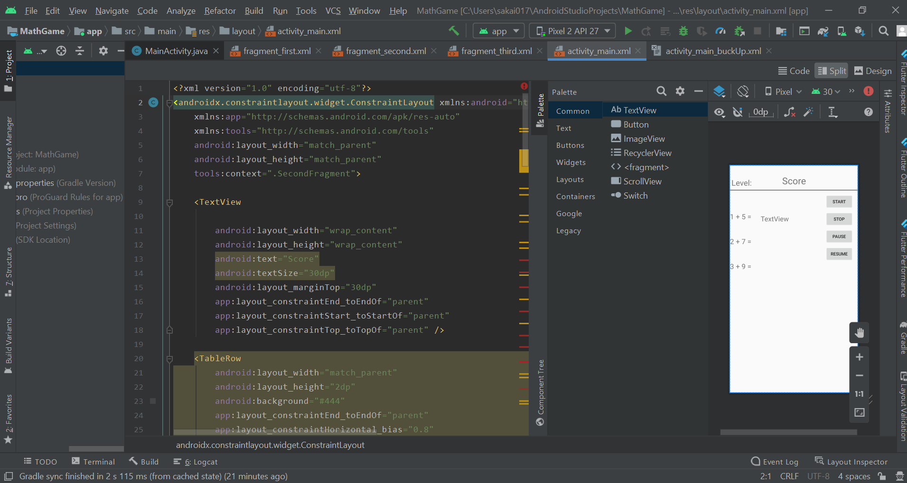
Contributions from Rena
I added buttons for start, stop, pause and resume.

Slide 18
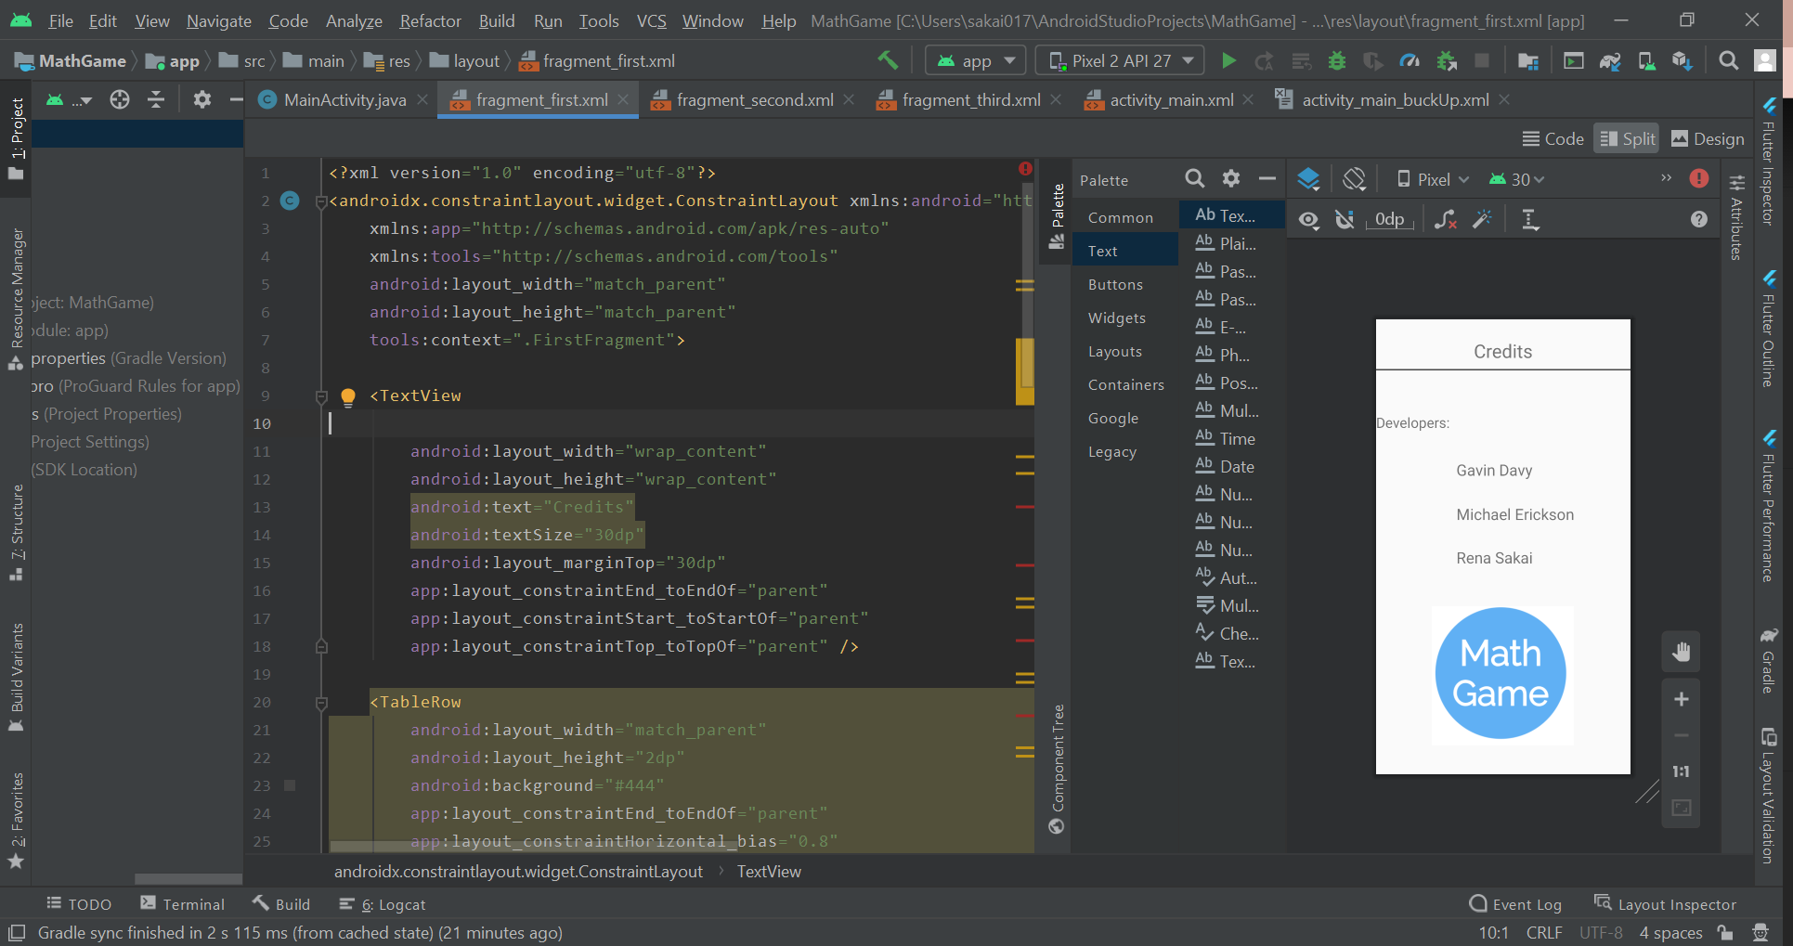
Contributions from Rena
I updated a credit page.

Slide 19
Next Two Weeks’ Plans:
Finish app screens
Create links between screen, as appropriate
Combine files into single project file on GitHub
Decide on naming conventions
Begin coding to allow user input on appropriate screens

